Slide 1


Design & Develop Front End Community Portal
Module Project
Module: NICF-UI Frameworks
Course: NICF-Advanced Certificate in Web Development
18 Jan 2022
14 Feb 2022
15 Feb 2022
Learner Name Enrollment ID
:
:
Start Date :
End Date : Submission Date :
Joshua Ho Gwok Hin
15 Feb 2022
Presentation Date :

Slide 2
Document History
Version Number | Effective Date of release | Summary of Included Changes | Author
1 | 4th March 2016 | First Edition | Satya CVS
2 | 7th April 2017 | Changed for Module 2 | Shrinivas K R
3 | 14th May 2017 | Changed for Module 3 | Shrinivas K R
4 | 03rd May 2018 | Changed for RQF | Shrinivas K R
5 | 16th Sep 2018 | Change for Java Track | Shrinivas K R

Slide 3
Contents
S. No. | Description
01 | Development Tools
02 | Feedback Techniques
03 | Pages Inventory
04 | Forms & Pages Design
05 | Forms & Pages Feedback
06 | HTML Pages
07 | Usability Metrics
08 | User Interaction Steps
09 | User Interaction Flowchart
10 | Current & Desired Usability
11 | Prototype Screen
12 | Prototype Feedback
13 | Usability Test
14 | Project Milestones & Tasks
15 | Milestone Feedback & Action taken
16 | Project Results
17 | Proposed Improvements

Slide 4

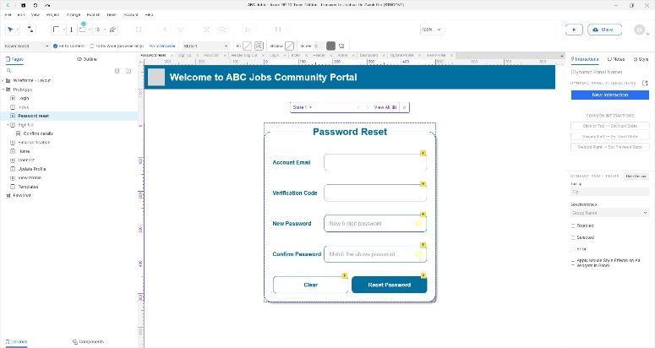
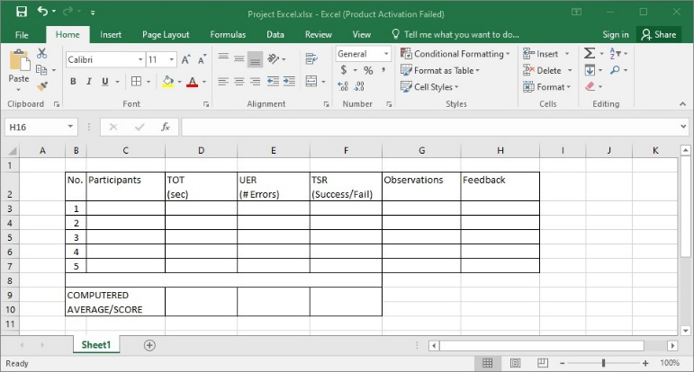
1. Development Tools
Development Tools Screen captures
Axure for Wireframing and Prototyping
Basic design concept are first created as wireframes in Axure. Design are then updated with interactions as prototypes for users to perform scenarios on the application.
The main reason for using Axure over other similar wire framing software is the ability to create interactions, providing a near to reality usability test.
Excel for recording success and gather user feedback
Record success and feedback through keen observation of users performing tasks.

Slide 5


2. Feedback Techniques
Feedback gathering techniques
 | Techniques and Methods | Brief description
1 | Interviewing | Communicate with users, get to know their pain points in using a product.
2 | Observation (Site Visiting) | Site visiting is very suitable for observing and collecting data based on real situation of users performing tasks.
3 | Conduct a study | Create an interview guide for the target user base that closely resembles Personas. Collect and record users as they think out loud. Write a report with findings. May include Success Rate KPI

Slide 6
3. Pages Inventory
List of Pages for which UI need to be developed
S. No. | Page Name
01 | Index – Community Portal Landing Page
02 | Log In
03 | Home – After Log in main page
04 | Connect – Connections & Search for other users
05 | Profile – View own profile
06 | Profile – Update Profile
07 | Password Reset (Redirect from Email link)
08 | Sign up – Register a new account
09 | Sign up – Confirm details entered
10 | Send Messages
11 | Post in Message Board
12 | List Message Board
13 | Read a Thread
14 | Post Job Opportunities
15 | List Job Opportunities & Responses

Slide 7
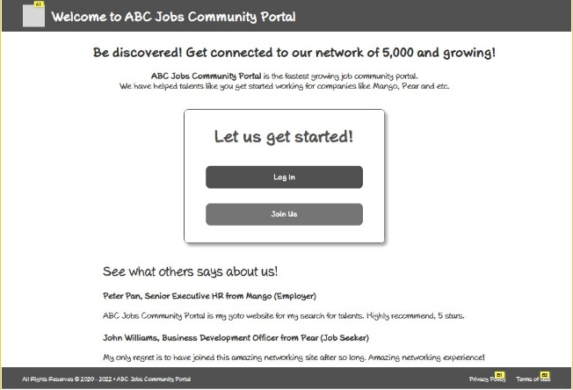
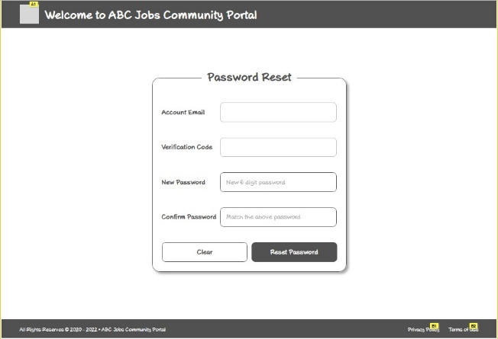
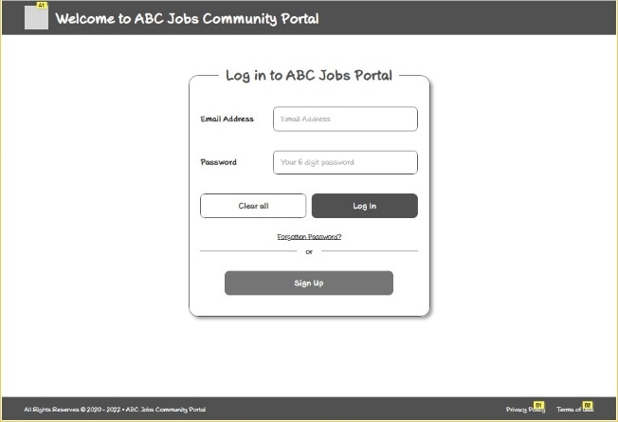
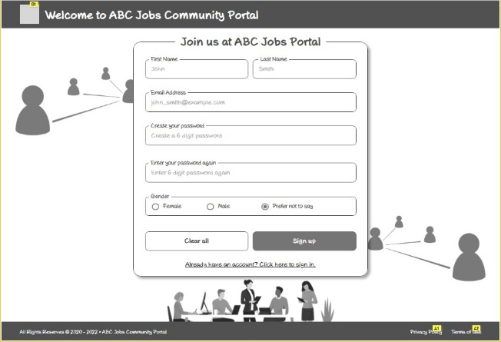
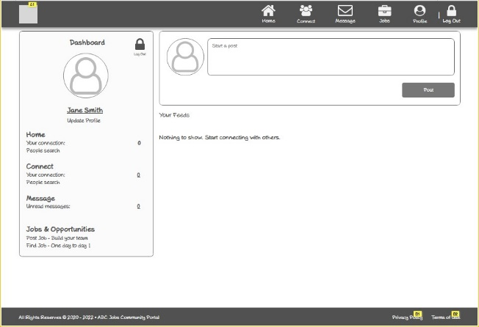
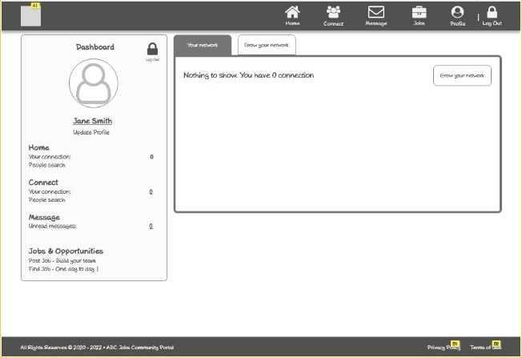
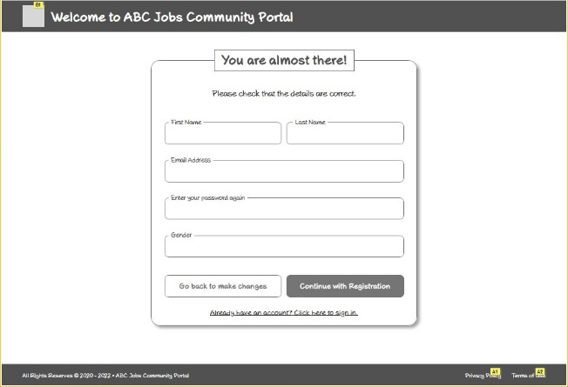
4. Forms & Pages Design

Slide 8
5. Forms & Pages Feedback
S. No. | Forms / Pages | Feedback Received | Modifications Implemented
01 | Sign Up | Required fields are not obvious | Added validation icons

Slide 9

6. HTML Pages
Screen capture of Pages

Slide 10
7. Usability Metrics
Time-on-task (TOT): Measured in seconds. User Error Rate (UER): In percentage. (No of Error/ Total Participants X 100%) Task Success Rate (TSR): In percentage. (No. of successful/ Total of Participants X 100%) Net Promoter Score (NPS): A scale of 0 to 10. 0-6 Detractors, 7-8 Passives and 9-10 as Promoters. Customer Satisfaction (CSAT): 1-2 Very Bad, 3-4 Poor, 5-6 Average, 7-8 Good, 9-10 Excellent

Slide 11
8. User Interaction Steps
Scenario 1: Login
User visit landing page and click on Log In button
User enter email address and password to click the submit button
Scenario 2: Registration
User visits landing page and click on Join Us button.
User enters required First Name, Email Address, Gender, Password and clicks Sign Up button
User redirected to confirm details page and check for errors, click Continue with Registration button
Pop up window for Email verification code, check and click Confirm my registration button
Redirected to login page
Scenario 3: Password Reset for Forgotten Password
User visit landing page and click on Log In button
User click on Forgotten Password? Link
Pop up request for Email address for password reset link and verification code to be sent.
Redirected to Password Reset page to key in new password with Password matching validation.
Pop up to inform Password Reset Successful. Click Proceed to log in page
Redirected back to log in page.

Slide 12
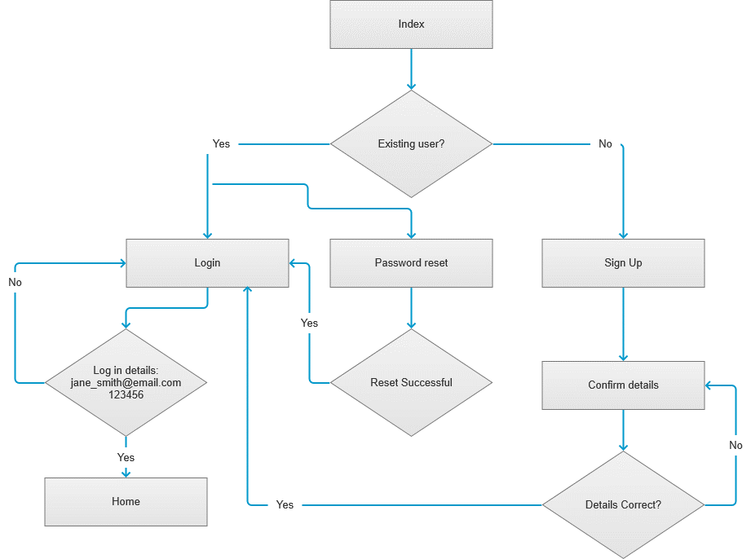
9. User Interaction Flowchart

Slide 13
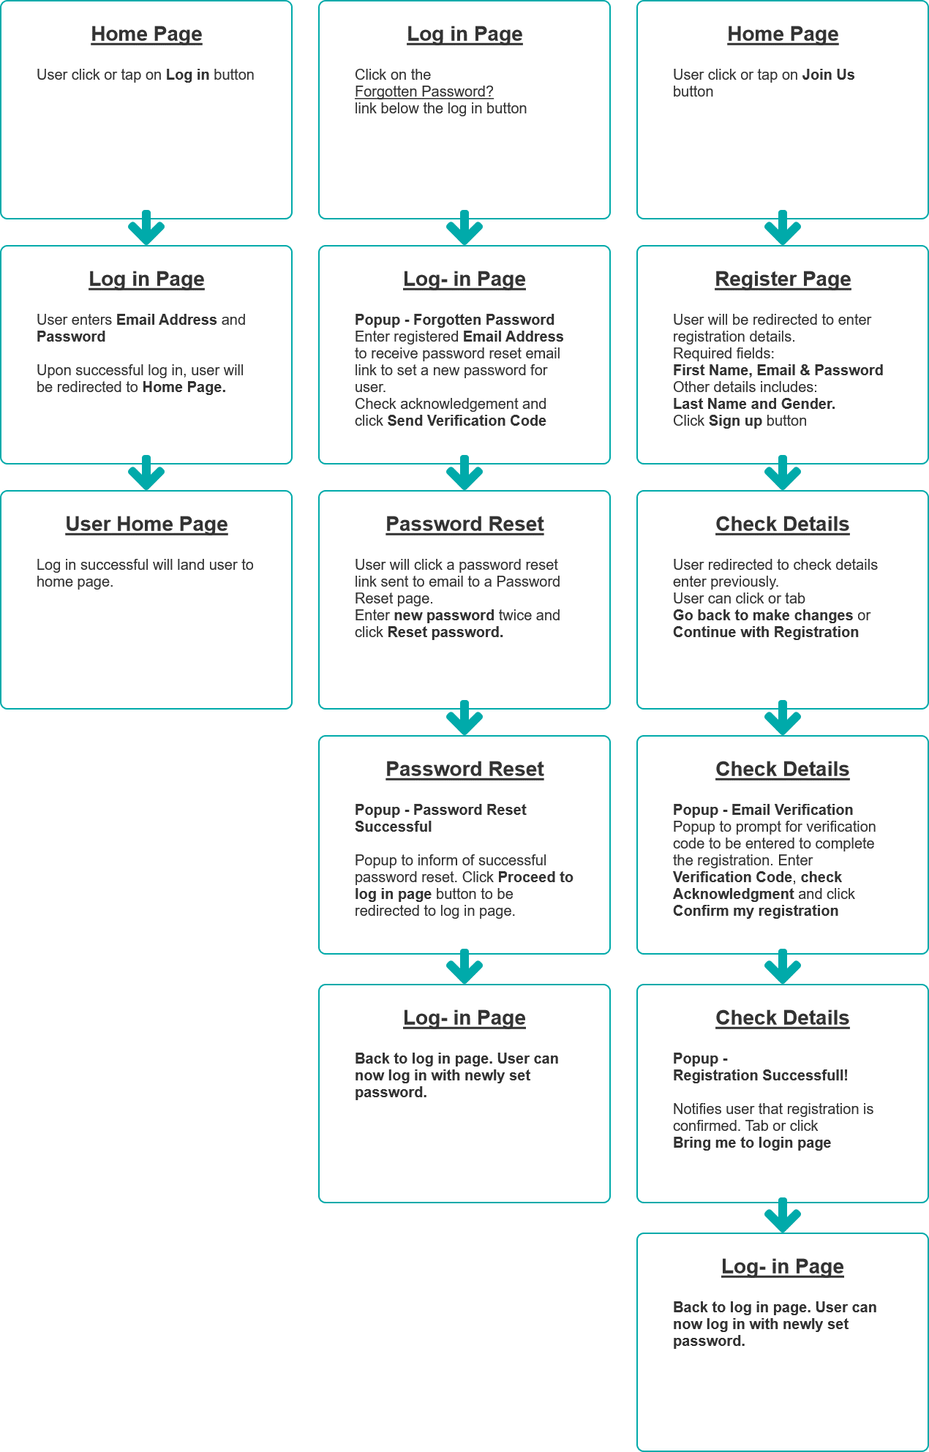
9. User Interaction Flowchart
Add logi function by function
If else representation
Should not be sitemap

Slide 14
10. Current & Desired Usability
Scenario | Desired |  |  | Current
 | TOT | TSR | UER | TOT | TSR | UER
1. Log In | 10 | 100% | 0% | 10 | 100% | 0%
2. Register an account | 20 | 100% | 0% | 22 | 100% | 0%
3. Password Reset | 15 | 100% | 0% | 14 | 100% | 0%

Slide 15
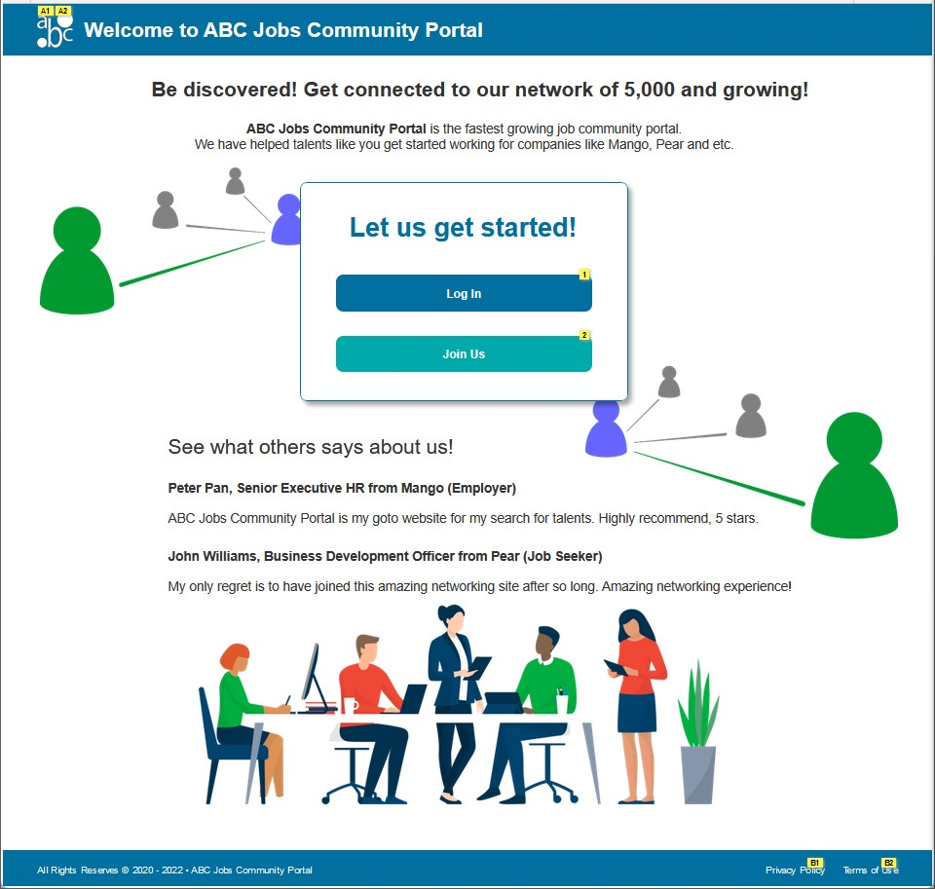
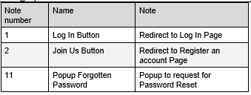
11. Prototype Screen – 1. Log In
Index - Landing page
Click Log In

Slide 16
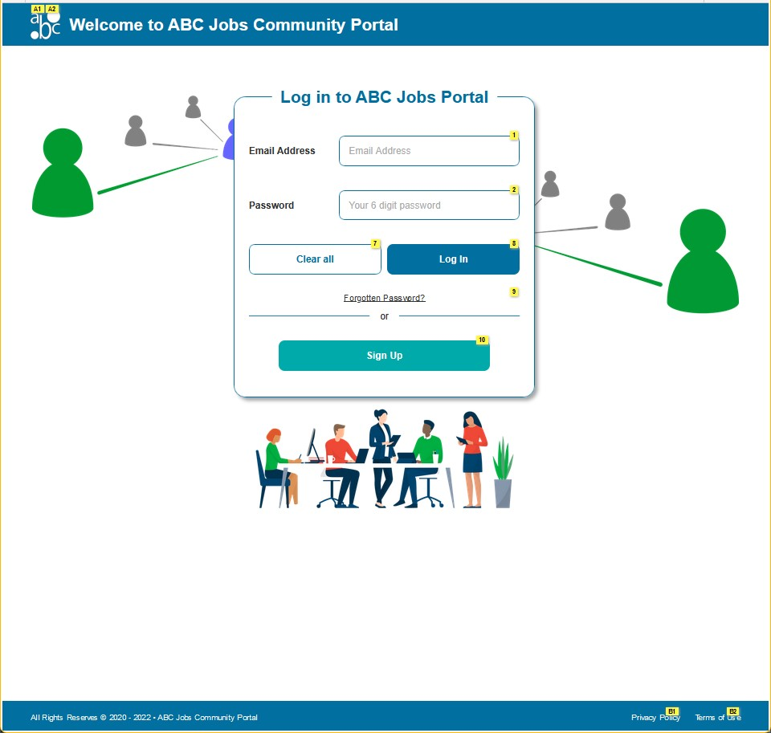
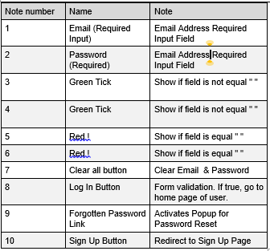
11. Prototype Screen – 1. Log In
Log In Page

Slide 17
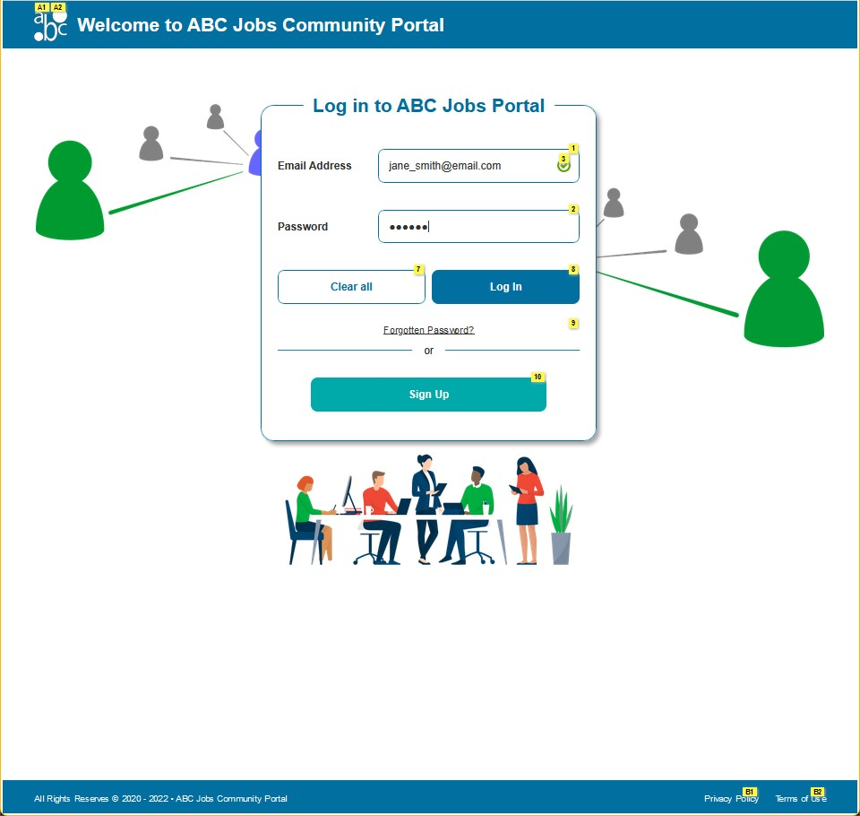
11. Prototype Screen – 1. Log In
Log In Page
Email Address:
Jane_smith@email.com
Password:
123456
Click Log In

Slide 18
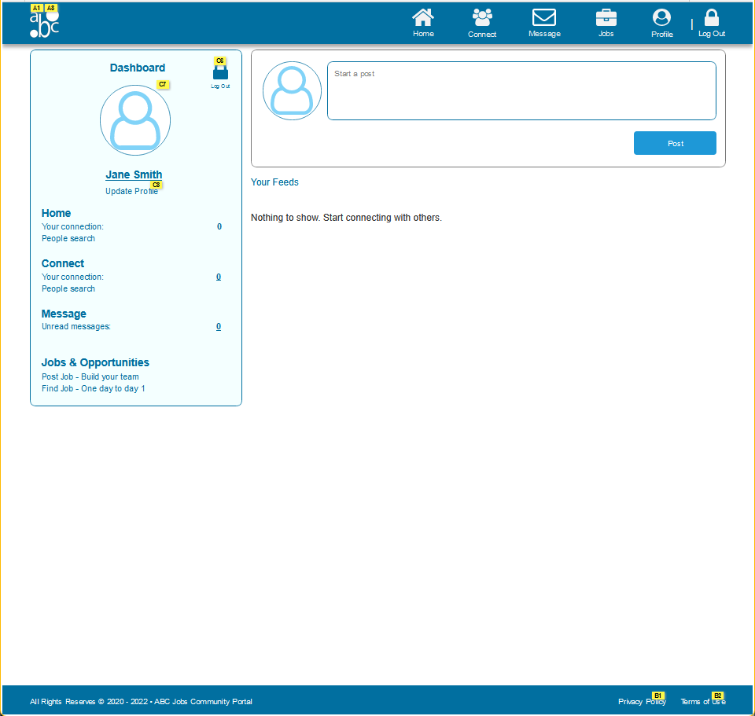
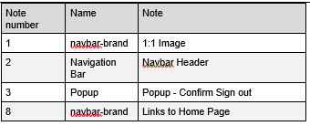
11. Prototype Screen – 1. Log In
Home Page
Log in successful

Slide 19
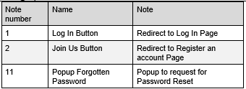
11. Prototype Screen – 2. Register
Index - Landing page
Click Join Us

Slide 20
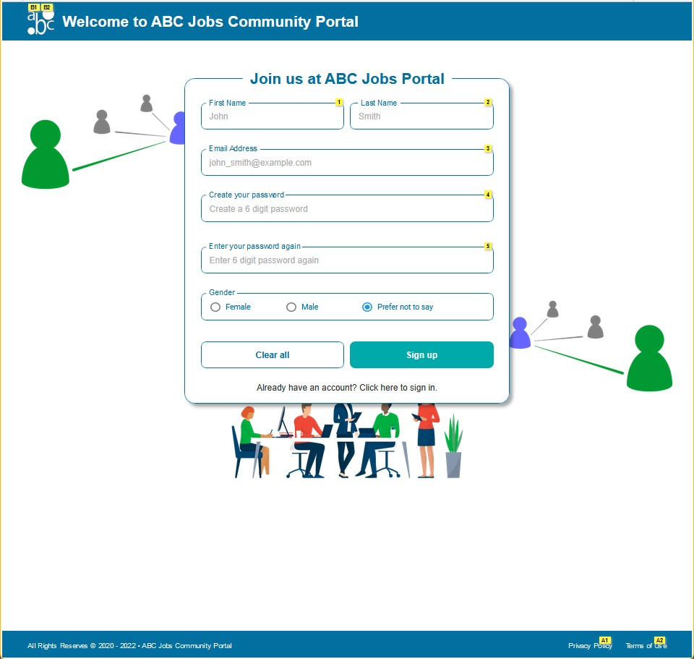
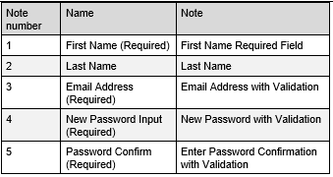
11. Prototype Screen – 2. Register
Register Page

Slide 21
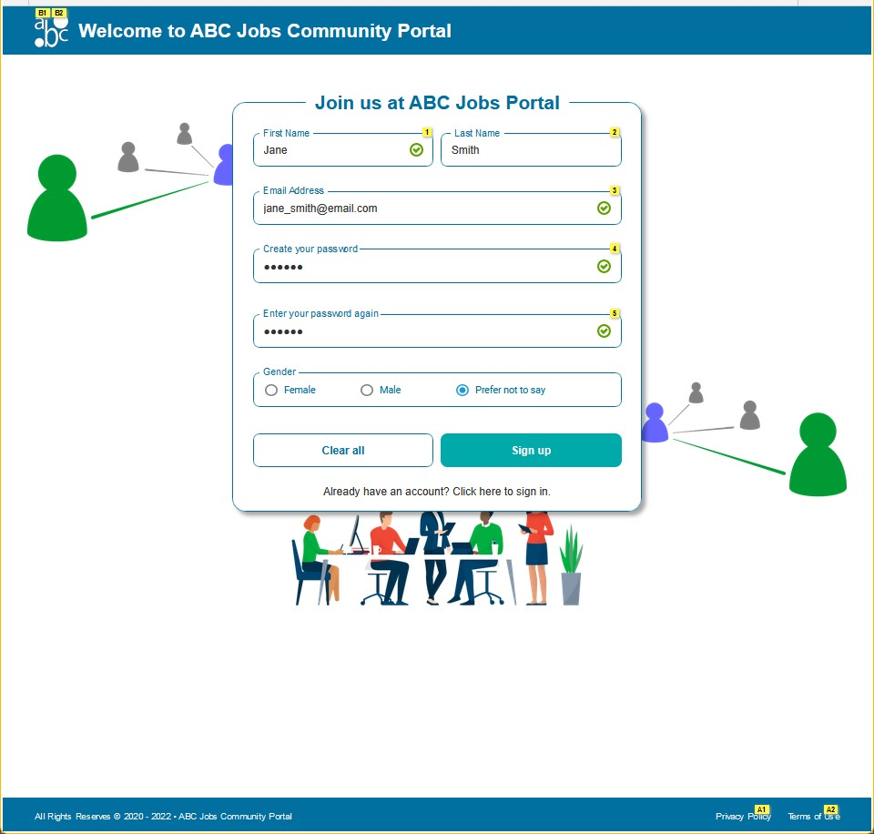
11. Prototype Screen – 2. Register
Register Page
First Name:
Jane
Last Name:
Smith
Email Address:
jane_smith@email.com
Password:
123456
Gender:
Prefer not to say
Click Sign Up

Slide 22
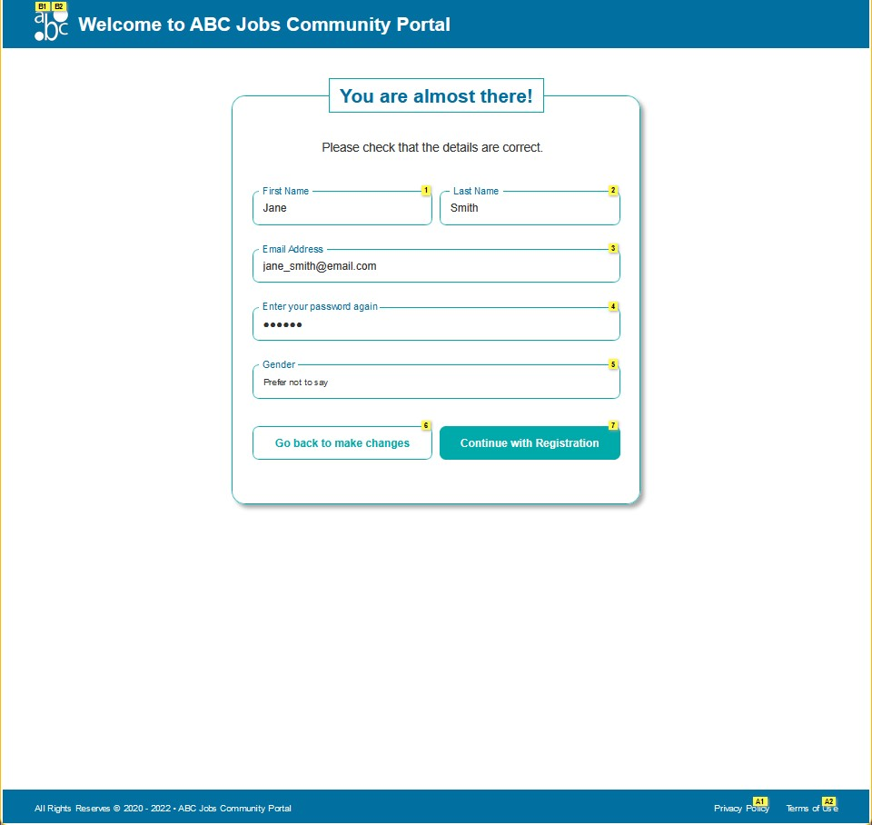
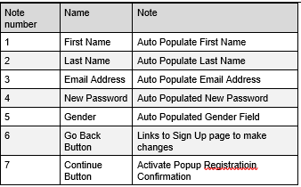
11. Prototype Screen – 2. Register
Confirm Details Page
Click
Continue with Registration

Slide 23
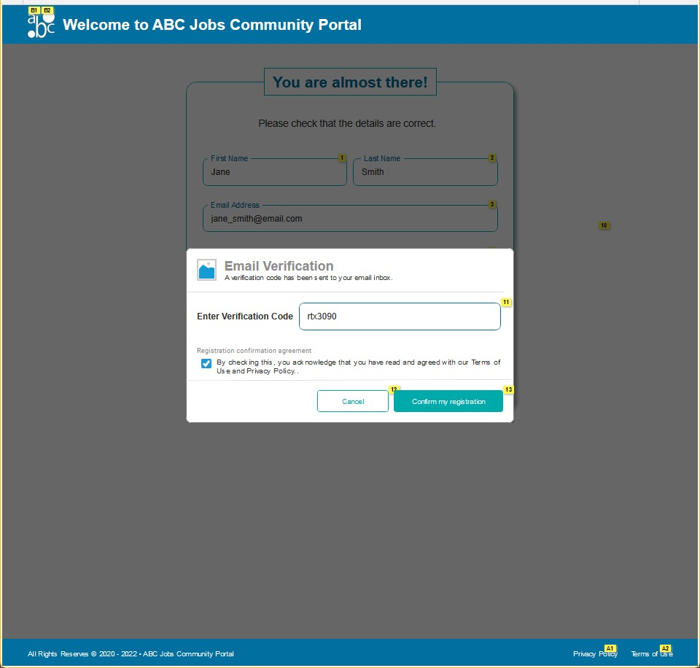
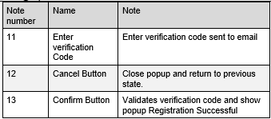
11. Prototype Screen – 2. Register
Pop Up - Email Verification
Enter the verification code
Sent to email.
Check Terms & Condition
Click
Confirm my registration

Slide 24
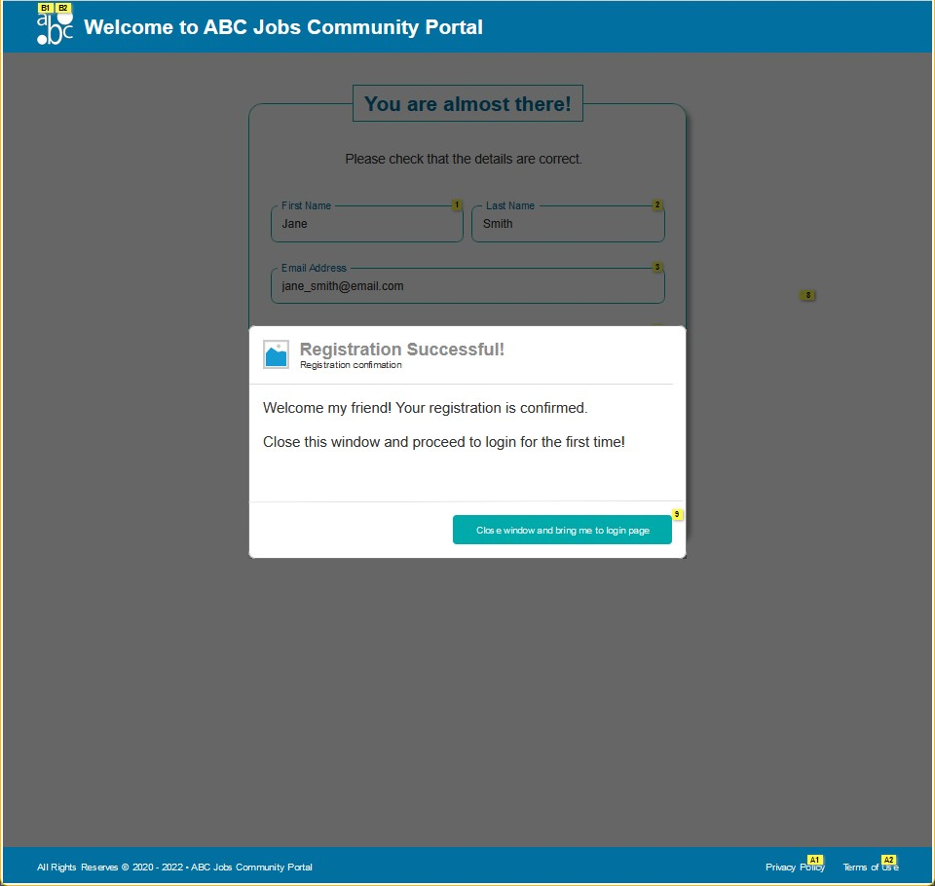

11. Prototype Screen – 2. Register
Pop Up - Registration Successful
Click
Close window to log in page

Slide 25
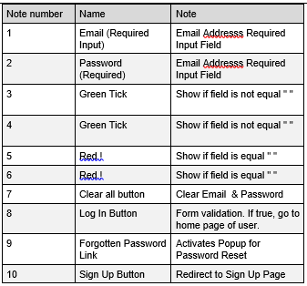
11. Prototype Screen – 2. Register
Log In Page
Back to log In page

Slide 26
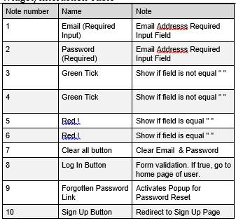
11. Prototype Screen - 3. Forget Password
Log In Page
Click
Forgotten Password?

Slide 27
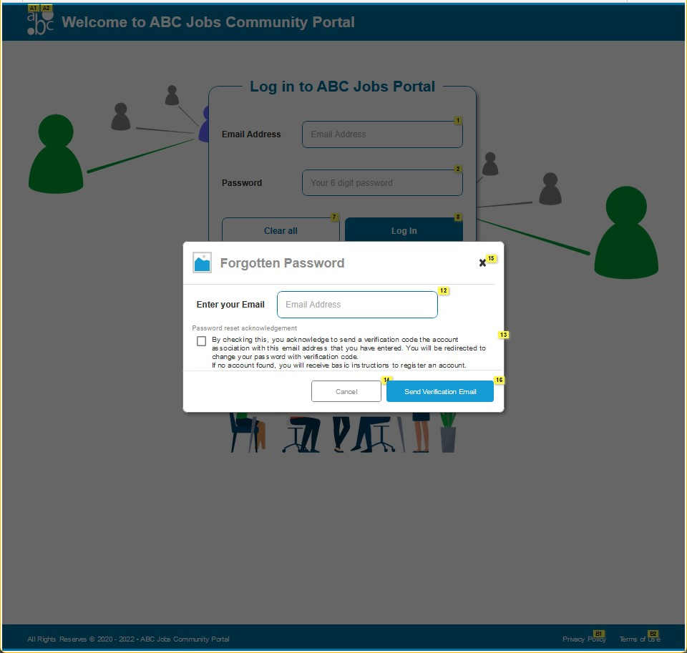
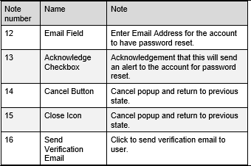
11. Prototype Screen - 3. Forget Password
Popup –
Forgotten Password
Enter Email:
jane_smith@email.com
Check the checkbox
Click
Send verification email

Slide 28
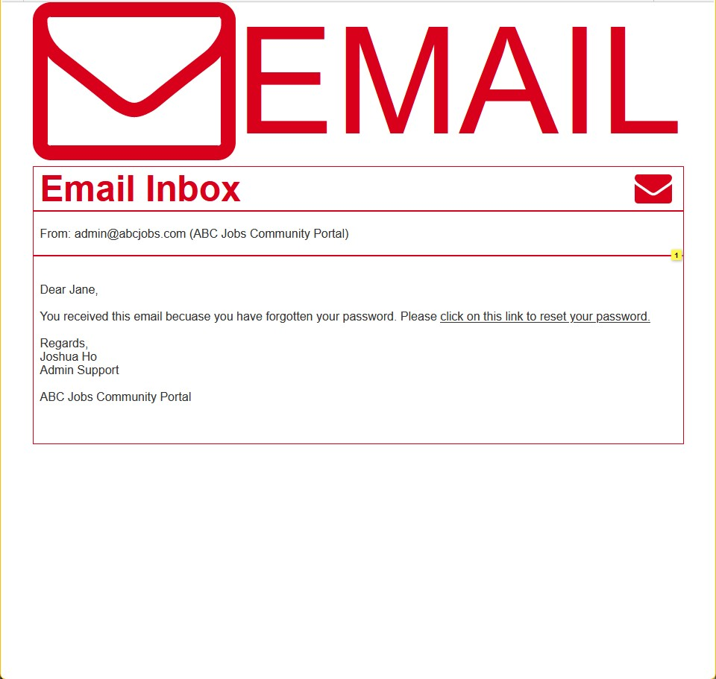

11. Prototype Screen - 3. Forget Password
Email Inbox
Check email from:
admin@abcjobs.com
Click click on this link to reset your
passord

Slide 29
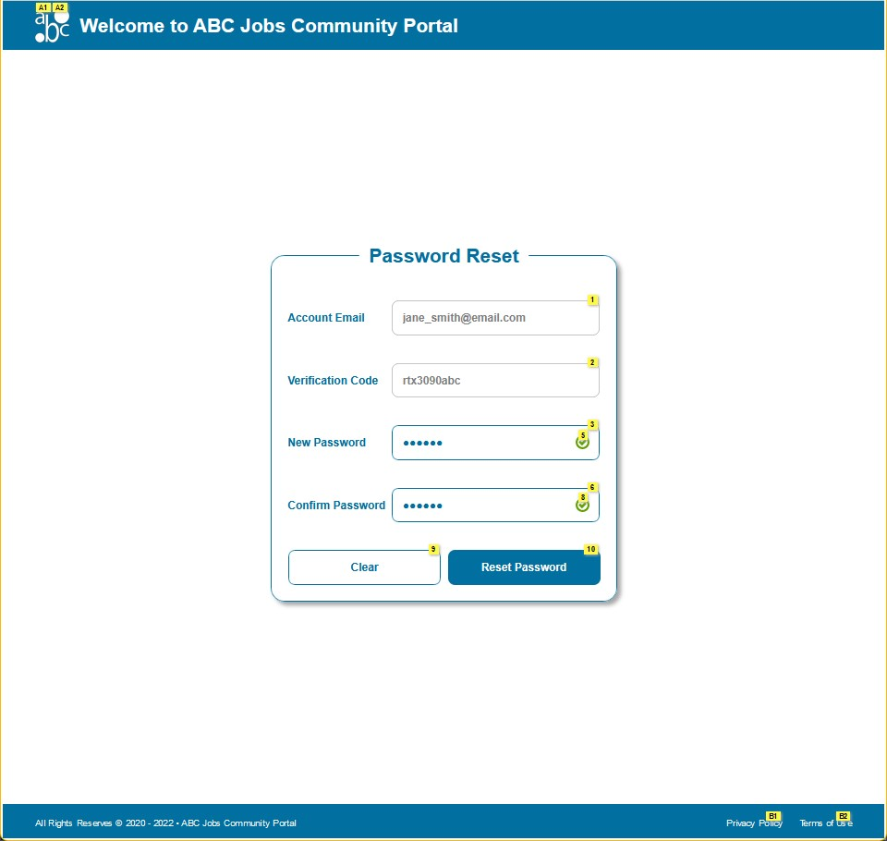
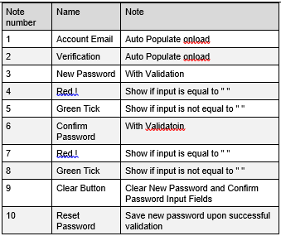
11. Prototype Screen - 3. Forget Password
Password Reset Page
New Password:
123456
Confirm Password:
123456
Click
Reset Password

Slide 30
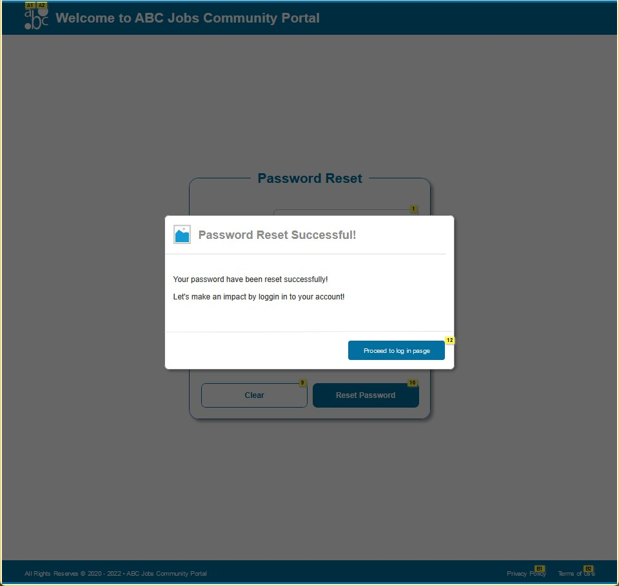

11. Prototype Screen - 3. Forget Password
Popup –
Password Reset Successful!
Click
Return to log in page

Slide 31
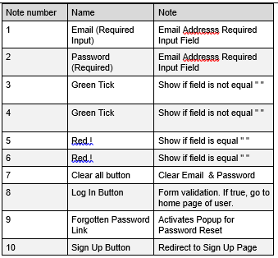
11. Prototype Screen - 3. Forget Password
Log In Page
Back to log In page

Slide 32
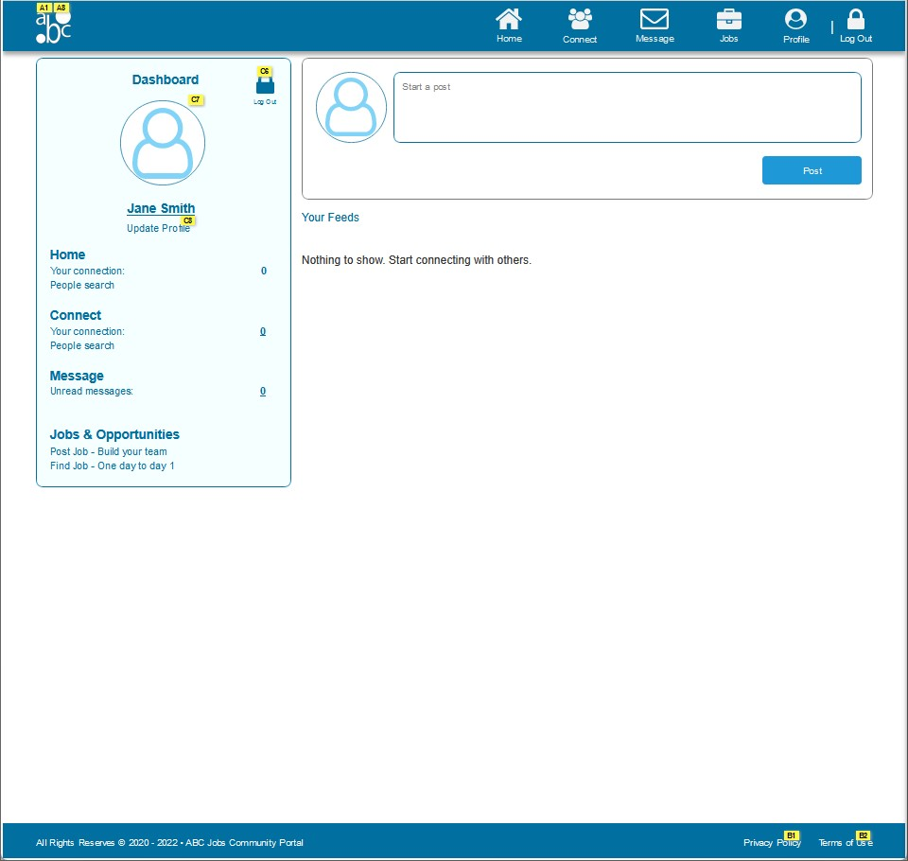
11. Prototype Screen - 4. Search Users
Home Page
Click
Connect

Slide 33
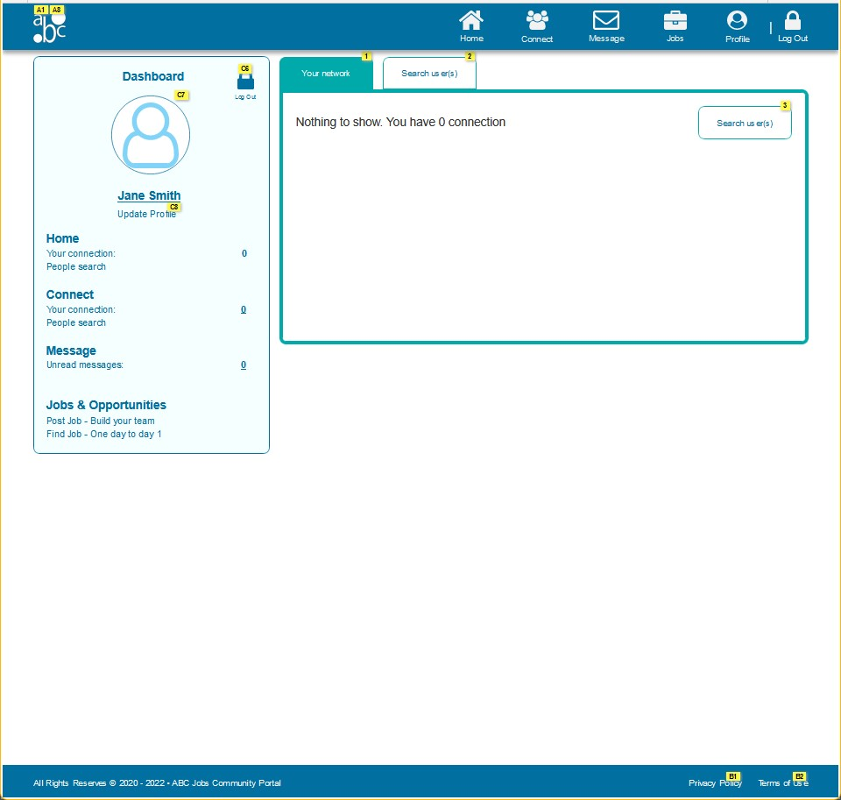
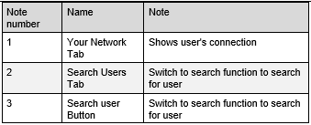
11. Prototype Screen - 4. Search Users
Connect Page
Click
Search User (tab)

Slide 34
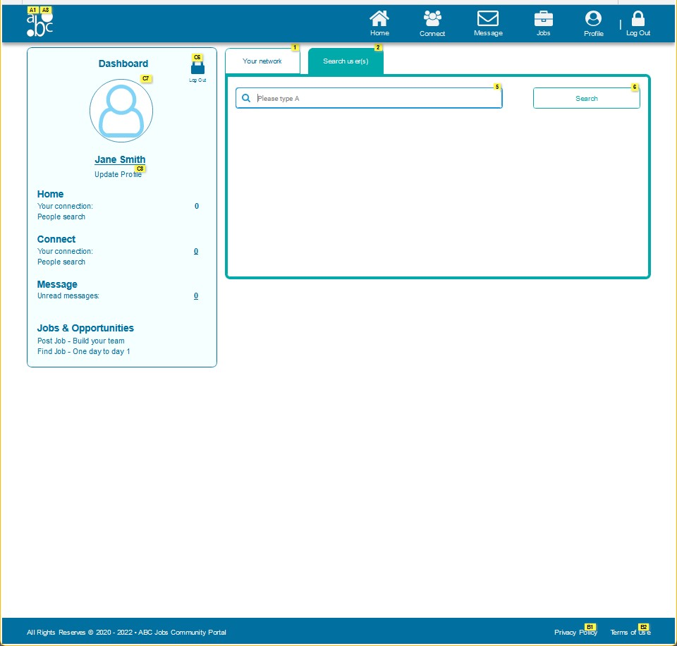
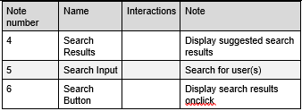
11. Prototype Screen - 4. Search Users
Connect Page –
Search Users
In the search box, type
A

Slide 35
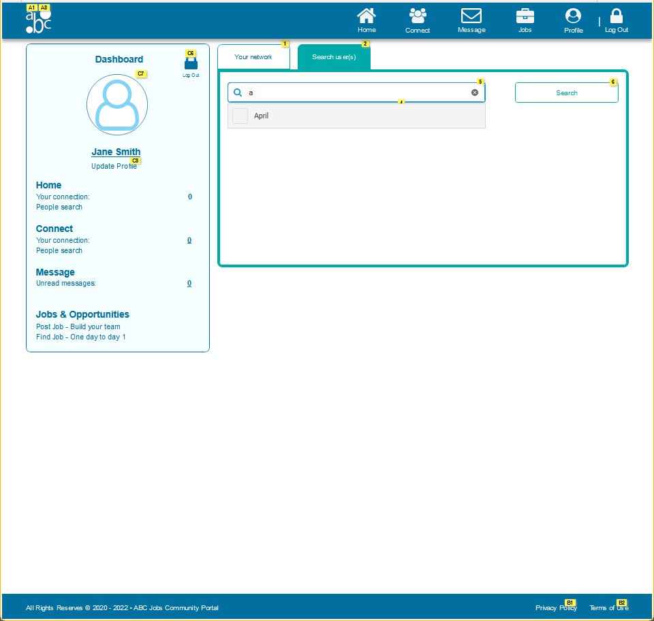
11. Prototype Screen - 4. Search Users
Connect Page –
Search Users
From dropdown list, select
April

Slide 36
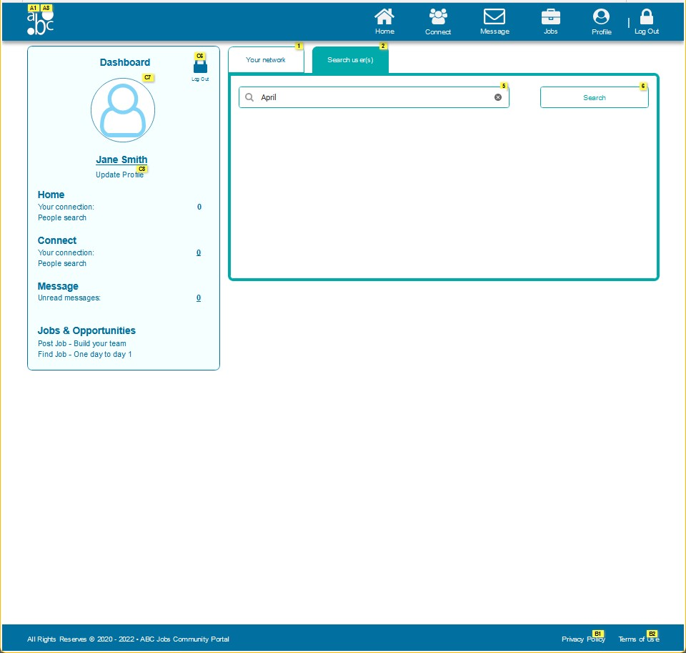
11. Prototype Screen - 4. Search Users
Connect Page –
Search Users
Click
Search

Slide 37
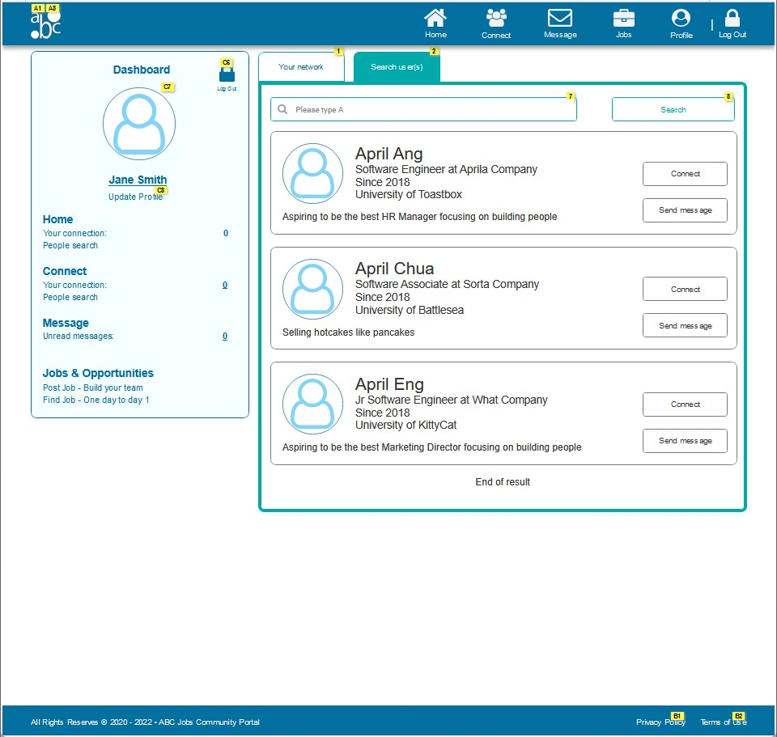

11. Prototype Screen - 4. Search Users
Connect Page –
Search Users
User result appears.

Slide 38
11. Prototype Screen - 5. Update Profile
Home Page
Click
Profile

Slide 39
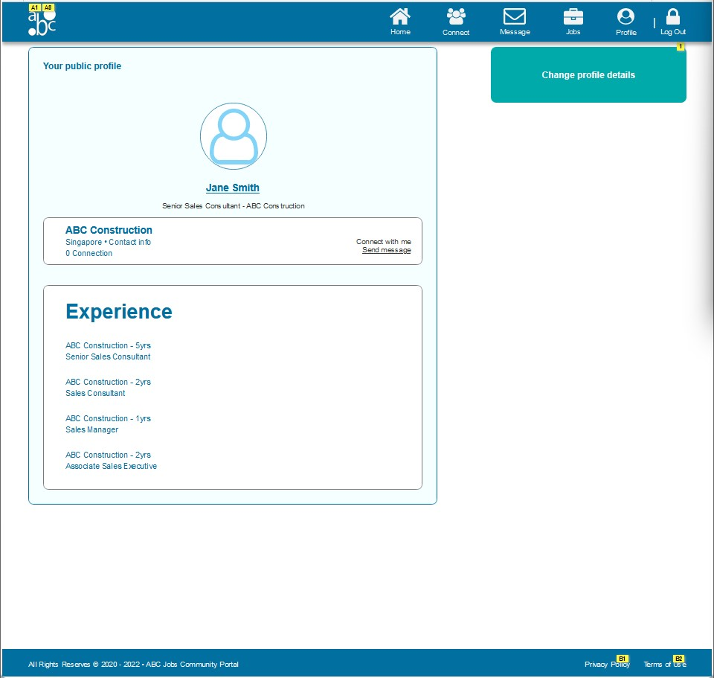

11. Prototype Screen - 5. Update Profile
View Profile Page
Click
Change Profile Details

Slide 40
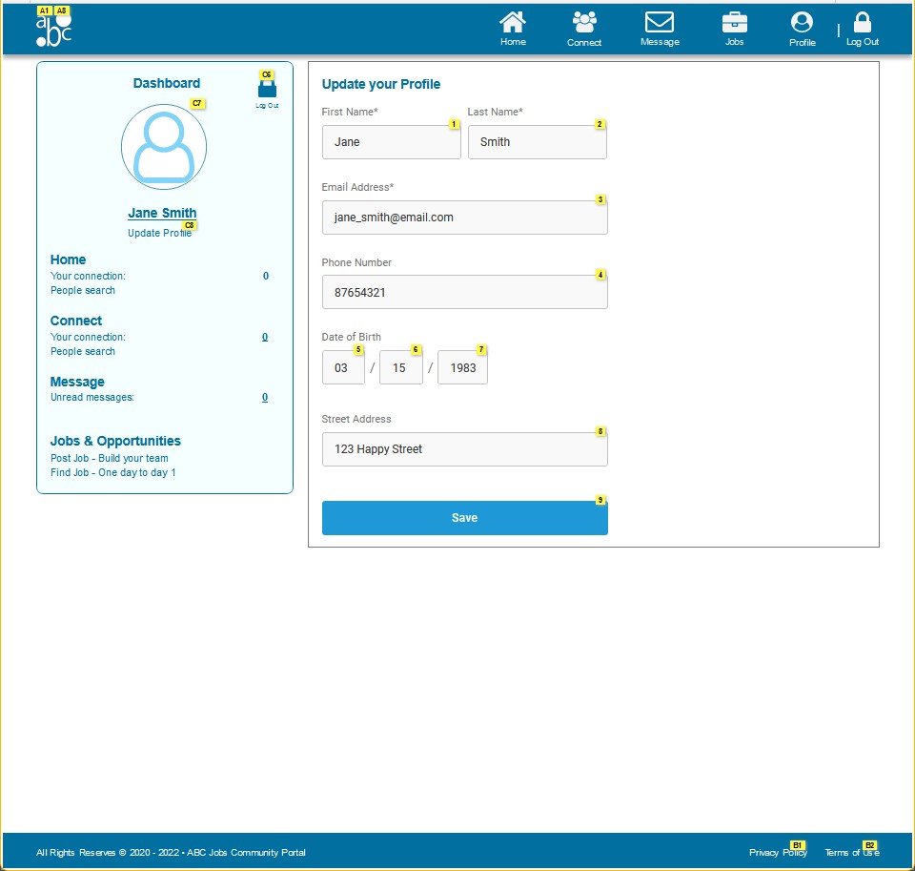
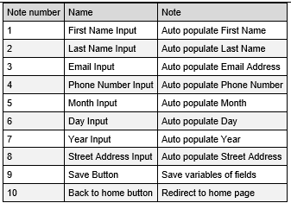
11. Prototype Screen - 5. Update Profile
Update Profile Page
Click
Save

Slide 41
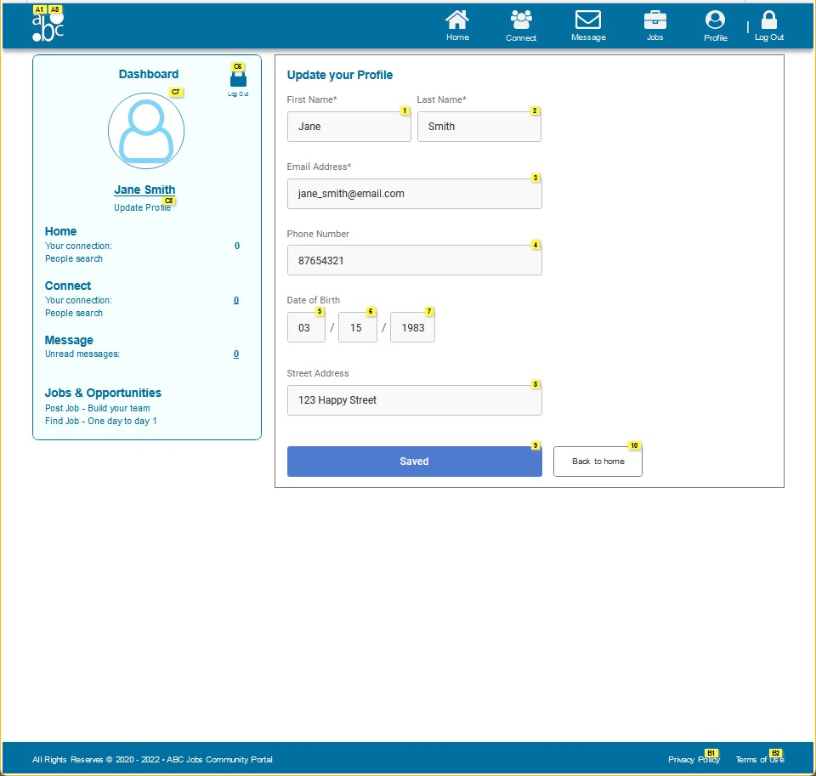
11. Prototype Screen - 5. Update Profile
Update Profile Page
Click
Back to home

Slide 42
12. Prototype Feedback
User Feedback Form User: Nilofar
No. | Document user’s feedback and response | Make suggestions to improve the user experience and implement them in prototype.
01 | Is the logo really grey in color? I don’t like the icon 😕 | Update design to match theme.
02 | When I am resetting password, I got the verification code pre-filled in the form after I key in the email. Do I need to type this somewhere? So anyone can put my email and change my password? | After resetting password, the close button will no longer redirect to verification page. For security reason, email verification page will only be able to access via email verification link.
03 | I can see the password I type in reset password… I don’t think this is safe… | Password input field to change to <input type="password">
04 | My profile is not updating after I change the name (scrolling is also a problem here) | Make adjustments to styling to troubleshoot for rendering error.
05 | Why are there no software programmers? | Double check and review Personas and test data to fulfill client’s requirement for next round of testing, if any.

Slide 43
13. Usability Test
Usability Tests Plan
No | Scenarios | No of user(s) | No of test conducted
1 | Log in | 5 | 5
2 | Password Reset | 5 | 5
3 | Register for an account | 5 | 5
4 | Search other users | 5 | 5
5 | Update Profile | 5 | 5

Slide 44
13. Usability Test
Metrics
No. | Participants | NPS Ratings (0-10) | CSAT Ratings (1-10) | TSR (Success/Fail)
1 | Danny | 8 | 9 | 100
2 | John | 7 | 7 | 100
3 | Eugene | 9 | 8 | 100
4 | Daniel | 7 | 8 | 100
5 | Shawn | 10 | 10 | 100
COMPUTERED AVERAGE/SCORE |  | 8.2 | 8.4 | 100%

Slide 45
13. Usability Test
No. | Participants | Feedback
1 | Danny | Looks boring with little or no variations in color palette
2 | John | I cannot change my profile picture?
3 | Eugene | I am not sure if the data are actually updated after changing some details
4 | Daniel | Everything seems fine but would be nice to make it look more interesting.
5 | Shawn | Pretty cool, let me know when it is ready I’d be coming onboard.

Slide 46
14. Project Milestones & Tasks
Project Task ID | Project Task Description | Project Milestone ID
1 | Provide a brief write-up on analyzing & gathering user feedback, Gather feedback from user and document. | 1
2 | Study the user experience & document. | 1
3 | Identify the performance level & gaps between user experience & desired user experience along with level of user engagement. | 1
4 | Develop & document 3 UX metrics | 2
5 | Create the steps in User Interaction Process along with the flow chart and document them. | 2
6 | Record the user response & documentation. | 2
7 | Create Prototype of the proposed system with at least 5 screens, screen capture and document them in Project Presentation | 3
8 | Gather feedback for the prototypes and document, make suggestions for improvement and document them in Project Presentation | 3
9 | Create usability tests and test them with users and document | 3

Slide 47
15. Milestone Feedback & Action taken
Project Milestone ID | Milestone Feedback received from Tutor / Learning Facilitator | Action Taken (Yes / No)
1
2
3

Slide 48

16. Project Results (1/2)
List of HTML Pages being Produced
<Label and paste the screen shots of all evidences which show the project outcome>
……
……
……
……
……
……
Links of the Pages
<>
……
……
……

Slide 49

16. Project Results (2/2)
Screen Capture of Pages Using Bootstrap & Angular
<Paste the Screen Captures>
……
……
……

Slide 50

17. Proposed Improvements
List of Improvements
No suggestions.

